Slide 1
Office Hours Tracking
By Ethan Tran, Bryson Brown, Chen-Hung Wu, Franklin Kao, Gourangi Taware, Nazar Oladepo, Nhat Nguyen

Slide 2
Client Needs
Our client needed a platform that allowed for students to mark when they were attending office hours so that TA’s could be assigned to busier times. The client also needed the TA’s to be able to mark that they were attending their office hours for billing purposes. Finally, the client needed to be able to download all of this data.

Slide 3
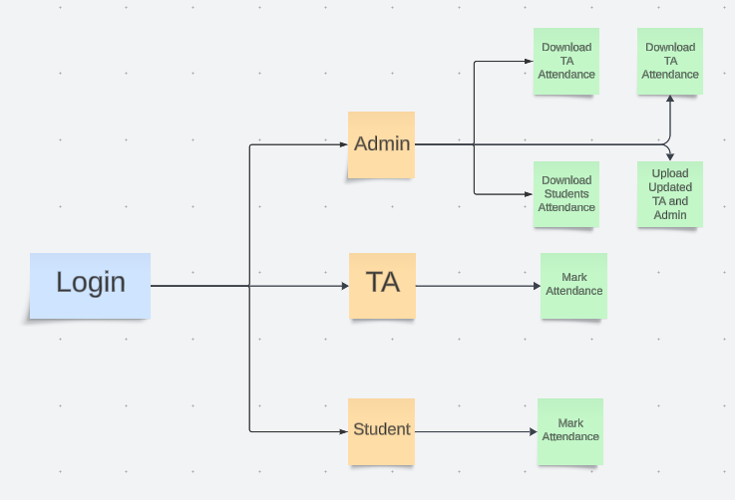

Our product
Our final product allows for students, TAs, and admins to login and see role-specific pages.
These pages have role-specific actions

Slide 4
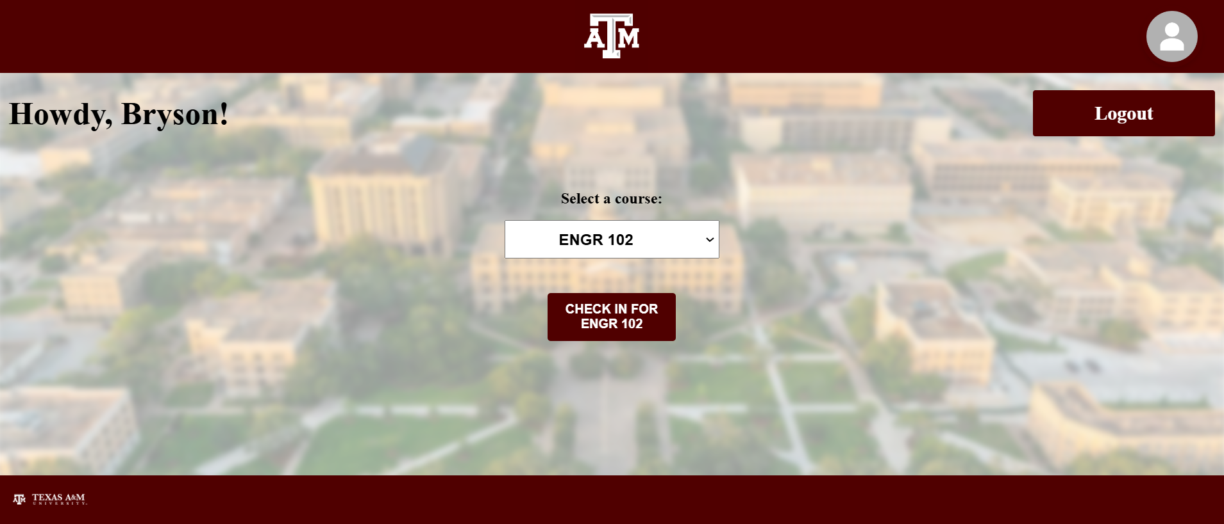
Student Page
COMPANY NAME
Students are first prompted for what class they are attending office hours for
They are then able to mark that they are there.

Slide 5

TA Page
COMPANY NAME
TA’s just need to mark that they are there.

Slide 6
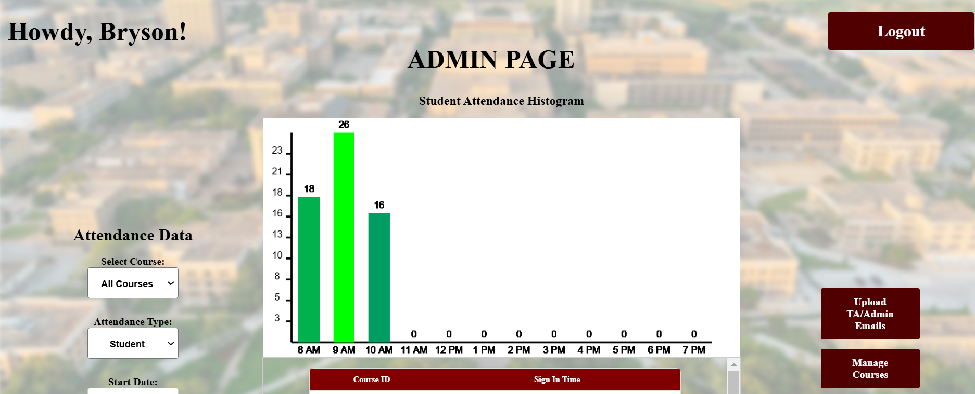
Admin Page
COMPANY NAME
Admins can download the TA/Student data for their selected time range
Admin can upload new TA/Admins
Admin can see the student attendance as a histogram over a selected time period
Admins can edit the classes that are shown to the students

Slide 7
THANK YOU
MM.DD.YY
CONFERENCE / EVENT PRESENTATION
FULL NAME
WEBSITE / PHONE NUMBER

